Slide 1

CAPITAL BUDGETING
Dr. Naresh Chandra Sahu
Associate Professor (Economics)
School of Humanities, Social Sciences & Management
Indian Institute of Technology, Bhubaneswar

Slide 2
Learning Outcomes
Understand the purpose and importance of capital budgeting in business decision-making.
Identify and analyze cash flows associated with long-term investment projects.
Apply key evaluation methods like NPV, IRR, and Payback Period to assess project viability.
Incorporate the time value of money in investment appraisals.
Evaluate risks and uncertainties impacting capital investment decisions.
Make informed recommendations for selecting profitable and strategic projects.

Slide 3
Capital Budgeting
Capital budgeting is the process by which companies evaluate and decide on long-term investments and projects. These investments usually involve significant amounts of money, such as:
Buying new machinery or equipment
Building a new factory
Launching a new product line
Expanding operations
The goal is to determine whether a project or investment is worth pursuing based on its potential to generate profits over time.

Slide 4
Capital Budgeting
Common examples of capital budgeting decisions:
Building a new factory
Buying new machinery
Launching a new product
Acquiring another company
Expanding into a new market

Slide 5

Objectives of Capital Budgeting
Maximize shareholder wealth
Evaluate and select the best investment opportunities
Ensure efficient allocation of capital resources
Minimize risk by assessing future uncertainties

Slide 6
Steps in the Capital Budgeting Process
Project Identification
Performance Review
Project Implementation
Project Selection
Project Evaluation

Slide 7
Steps in the Capital Budgeting Process
Project Identification
Identify potential investment opportunities (e.g., building a new plant, purchasing machinery).
Project Evaluation
Forecast future cash flows of each project.
Evaluate risk and strategic alignment.
Project Selection
Apply quantitative techniques to compare projects.
Select the project(s) that add the most value.
Project Implementation
Allocate resources and start executing the project.
Performance Review
Monitor outcomes and compare with projections.
Learn from discrepancies.

Slide 8
Capital Budgeting Techniques
Payback Period
Discounted Payback Period
Net Present Value (NPV)
Internal Rate of Return (IRR)

Slide 9
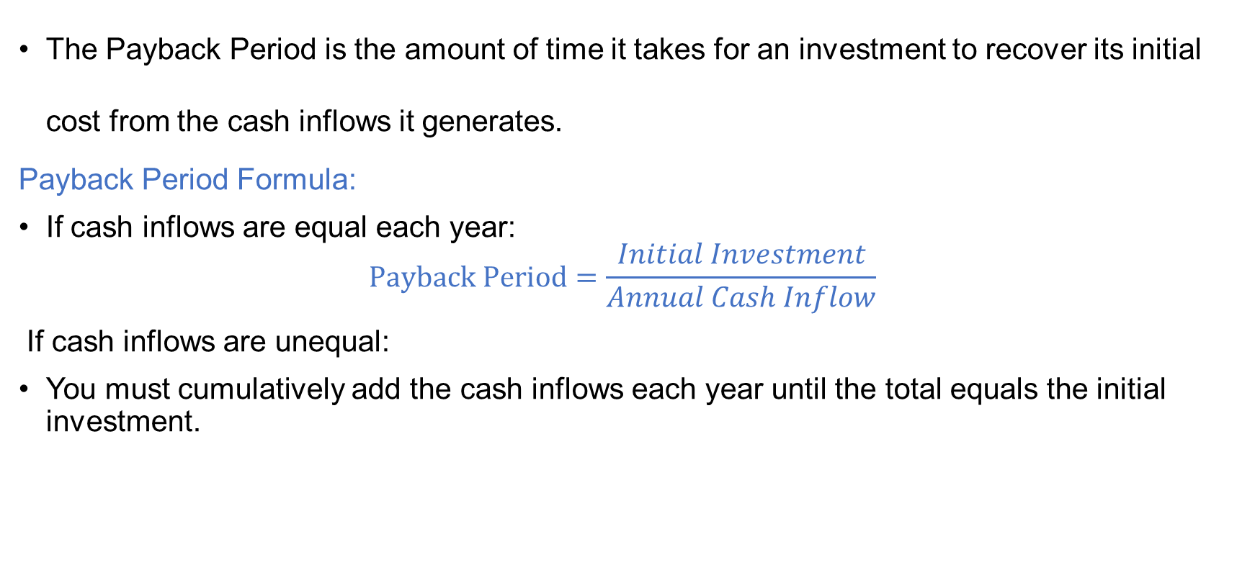
Payback Period
The Payback Period is the amount of time it takes for an investment to recover its initial cost from the cash inflows it generates.
Payback Period Formula:
If cash inflows are equal each year:
$$Payback Period=\frac{Initial Investment}{Annual Cash Inflow}$$
If cash inflows are unequal:
You must cumulatively add the cash inflows each year until the total equals the initial investment.

Slide 10
Payback Period Decision Rule
If Payback Period ≤ Target Payback Period → Accept the project
If Payback Period > Target → Reject the project
Example: If a company's policy is to accept only projects with a payback period under 3 years, a project with a payback of 2.5 years would be accepted.

Slide 11

Example 1: Equal Cash Flows
Initial Investment = 40,000 ₹
Annual Cash Inflow = 10,000 ₹
Payback Period $= \frac{40,000}{10,000} \text{=4 }\text{years}$

Slide 12
Advantages of Payback Period
Simple to calculate and understand.
Emphasizes liquidity — useful for firms with cash flow concerns.
Good for quick, preliminary screening of projects.
Reduces risk by focusing on how quickly the investment is recovered.

Slide 13
Disadvantages of Payback Period
Weakness | Explanation
Ignores Time Value of Money | ₹1 today ≠ ₹1 in future — not considered in basic payback.
Ignores Cash Flows After Payback | Doesn’t consider long-term profitability.
Arbitrary Benchmark | Target payback period may not reflect actual risk or opportunity cost.
Not Ideal for Strategic or Long-Term Projects | Can lead to rejecting valuable long-term investments.

Slide 14
Summary
Feature | Payback Period
Focus | Liquidity / Risk
Easy to Use? | Yes
Considers TVM? | No (Yes if discounted)
Long-Term Focus? | No
Decision Rule | Accept if payback ≤ cutoff

Slide 15
Discounted Payback Period
The Discounted Payback Period is the amount of time it takes for the present value of an investment’s cash inflows to recover the initial investment.
Unlike the regular payback period, it discounts each cash flow using a required rate of return or cost of capital before summing.
How to Calculate Discounted Payback Period:
Determine the discount rate (usually cost of capital).
Calculate the present value (PV) of each cash inflow:

Slide 16
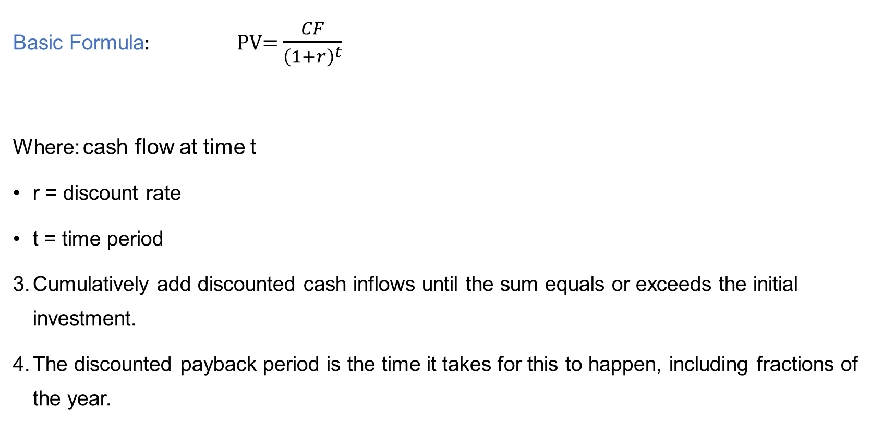
Discounted Payback Period
Basic Formula: PV= $\frac{CF}{{\left(1+r\right)}^{t}}$
Where: cash flow at time t
r = discount rate
t = time period
Cumulatively add discounted cash inflows until the sum equals or exceeds the initial investment.
The discounted payback period is the time it takes for this to happen, including fractions of the year.

Slide 17
Example
Initial Investment: ₹ 10,000
Cash Inflows:
Year 1: ₹ 3,000
Year 2: ₹ 4,000
Year 3: ₹ 4,000
Discount Rate: 10%
Step 1: Calculate discounted cash inflows
Year | Cash Flow | Discount Factor (10%) | Discounted Cash Flow (DCF)
1 | 3,000 | 1 / (1.10)^1 = 0.9091 | 3,000 × 0.9091 = 2,727.30
2 | 4,000 | 1 / (1.10)^2 = 0.8264 | 4,000 × 0.8264 = 3,305.60
3 | 4,000 | 1 / (1.10)^3 = 0.7513 | 4,000 × 0.7513 = 3,005.20

Slide 18
Example
Step 2: Calculate cumulative discounted cash inflows
Year | Discounted Cash Flow | Cumulative DCF
1 | 2,727.30 | 2,727.30
2 | 3,305.60 | 2,727.30 + 3,305.60 = 6,032.90
3 | 3,005.20 | 6,032.90 + 3,005.20 = 9,038.10

Slide 19
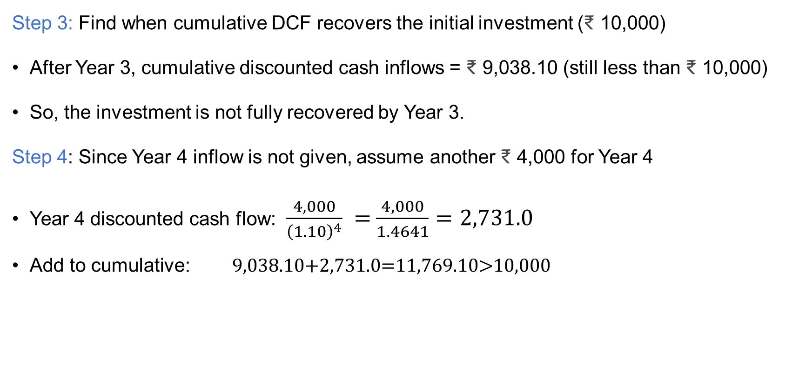
Example
Step 3: Find when cumulative DCF recovers the initial investment (₹ 10,000)
After Year 3, cumulative discounted cash inflows = ₹ 9,038.10 (still less than ₹ 10,000)
So, the investment is not fully recovered by Year 3.
Step 4: Since Year 4 inflow is not given, assume another ₹ 4,000 for Year 4
Year 4 discounted cash flow: $\frac{4,000}{{\left(1.10\right)}^{4}} =$ $\frac{4,000}{1.4641}=2,731.0$
Add to cumulative: 9,038.10+2,731.0=11,769.10>10,000

Slide 20

Example
Step 5: Calculate the fractional year to recover the remaining amount:
Remaining amount at end of Year 3 = ₹ 10,000 - 9,038.10 = ₹ 961.90
Fraction of Year 4 needed = $\frac{961.90}{2,731.0}=$0.35 years

Slide 21
Advantages of Discounted Payback Period
Considers the time value of money.
Helps evaluate investment liquidity while adjusting for risk and cost of capital.
Useful in risk management, especially where early recovery of investment is critical.

Slide 22
Disadvantages
Ignores cash flows that occur after the payback period (just like traditional payback).
More complex to calculate than simple payback.
Can still reject projects with positive NPV if payback takes too long.
Not a complete measure of profitability.

Slide 23
When to Use Discounted Payback Period
When time value of money matters but you still want a liquidity measure.
For projects where early cash recovery is important.
In combination with other metrics like NPV and IRR.

Slide 24
Discounted Payback vs Payback Period
Feature | Payback Period | Discounted Payback Period
Time Value of Money | No | Yes
Complexity | Simple | More complex
Decision Focus | Liquidity | Liquidity + TVM
Considers Full Cash Flows | No | No
Practical Use | Quick screening | More accurate screening

Slide 25
Summary
Step | Description
1. Discount cash flows | Calculate PV of each cash inflow
2. Cumulative sum | Add discounted cash flows cumulatively
3. Determine payback | Identify when cumulative PV equals initial cost
4. Calculate fraction | Find fraction of the final year needed

Slide 26
Questions
Question 2:
Why might the discounted payback period still be insufficient for making investment decisions despite considering the time value of money?

Slide 27
Answer
Though DPP accounts for the time value of money, it ignores cash flows beyond the payback period, which can be significant. This limitation can lead to rejecting projects that are profitable in the long run but recover the investment slowly. It also doesn’t measure overall profitability or compare the scale of projects, so relying solely on DPP can result in suboptimal decisions.

Slide 28
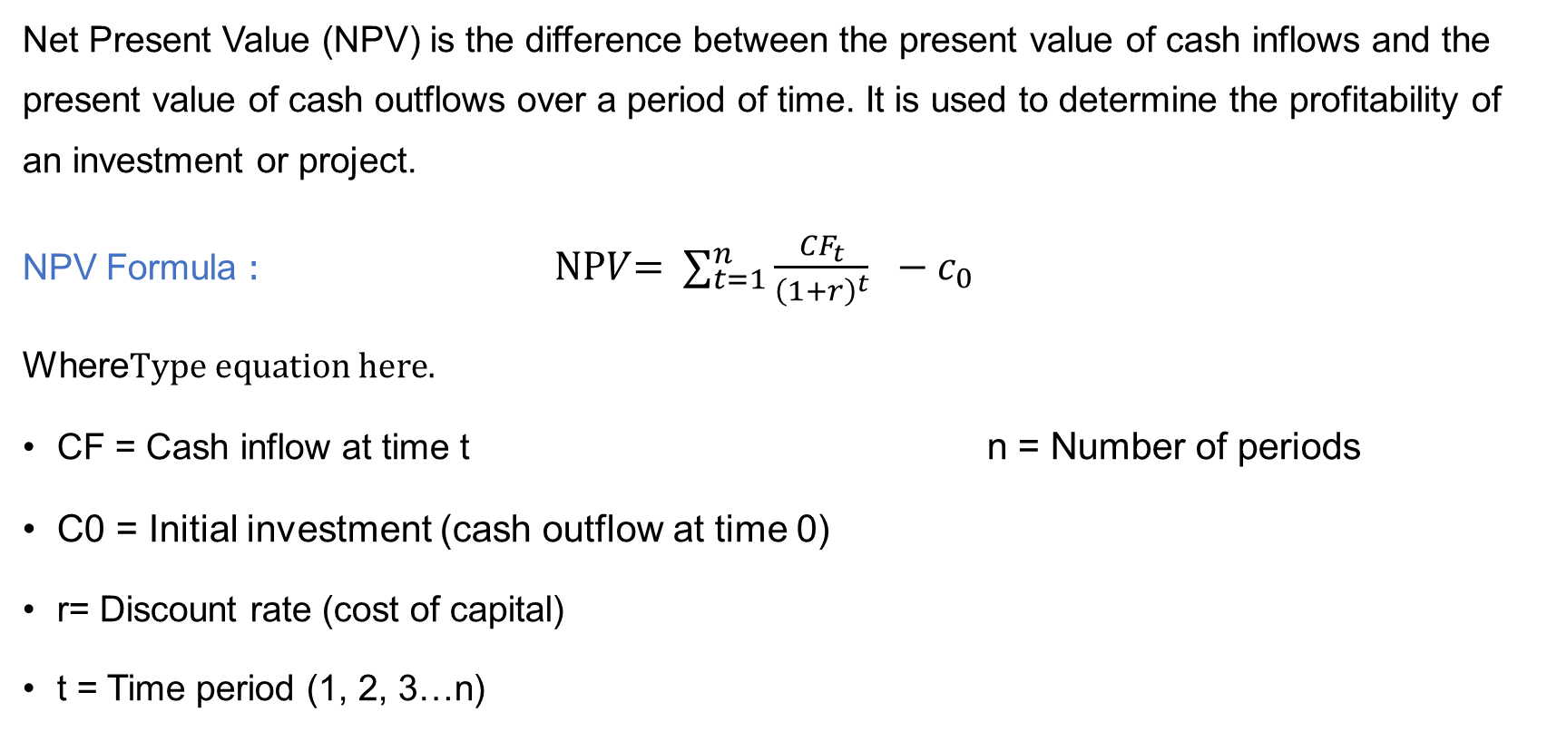
Net Present Value (NPV)
Net Present Value (NPV) is the difference between the present value of cash inflows and the present value of cash outflows over a period of time. It is used to determine the profitability of an investment or project.
NPV Formula : NP$V$=$∑_{t=1}^{n}\frac{{CF}_{t}}{{\left(1+r\right)}^{t}} −c_{0}$
Where
CF = Cash inflow at time t n = Number of periods
C0​ = Initial investment (cash outflow at time 0)
r= Discount rate (cost of capital)
t = Time period (1, 2, 3…n)

Slide 29
Key Concepts in NPV
1. Time Value of Money (TVM)
A rupee today is worth more than a rupee tomorrow.
NPV discounts future cash flows to reflect this.
2. Discount Rate
Usually, the company’s cost of capital or required rate of return.
Reflects the opportunity cost and risk of the investment.
3. Cash Flows
Only relevant (incremental) cash flows are considered — not accounting profits.

Slide 30
NPV Decision Rule
NPV > 0 → Accept the project (adds value to the firm)
NPV < 0 → Reject the project (destroys value)
NPV = 0 → Indifferent (no gain, no loss)

Slide 31
Example of NPV Calculation
Project: A company is considering investing ₹ 10,000 in a project expected to generate the following cash inflows over 4 years. The company’s required rate of return (discount rate) is 10%.
Year | Cash Inflow (CF)
1 | ₹3,000
2 | ₹4,000
3 | ₹4,000
4 | ₹2,000

Slide 32

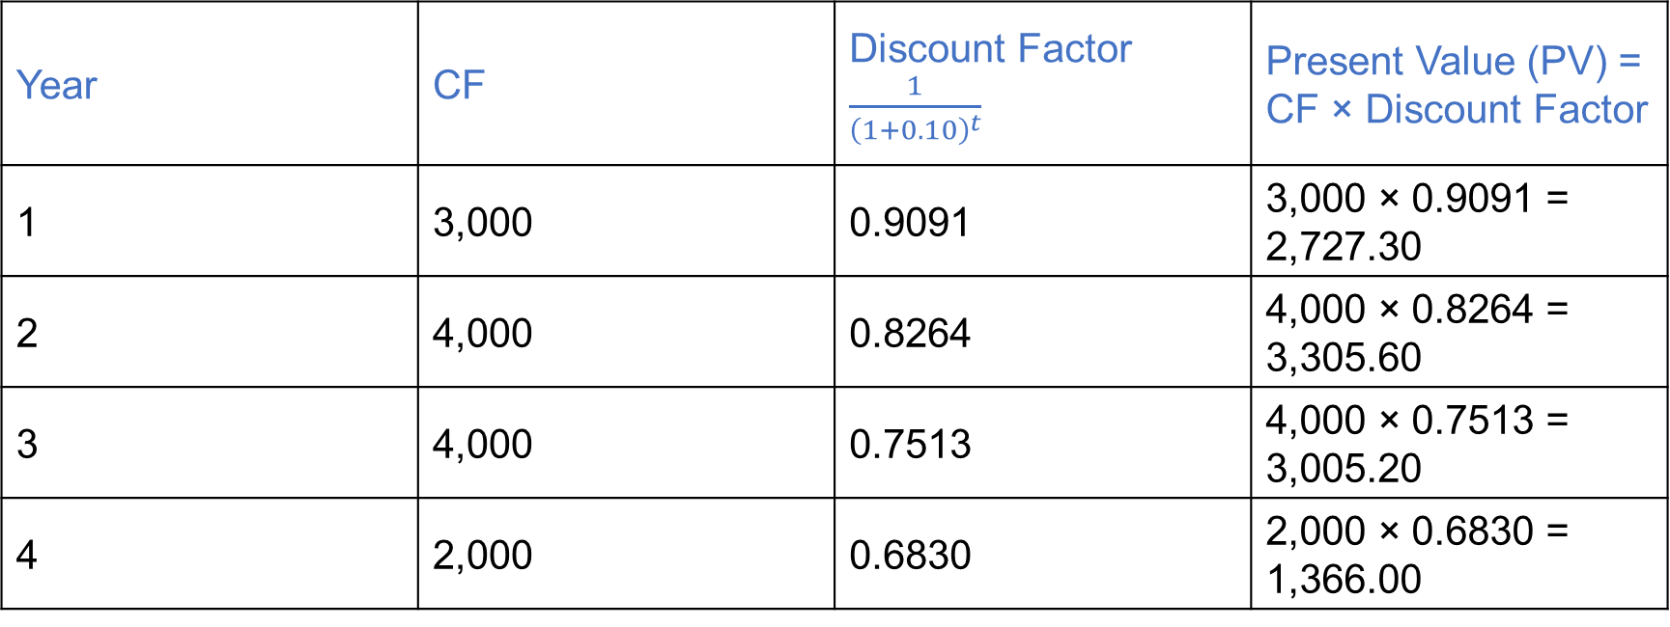
Example of NPV Calculation
Answer: Step 1: Write down the formula NP$V$=$∑_{t=1}^{4}\frac{CF}{{\left(1+0.10\right)}^{t}} −10,000$
Step 2: Calculate present value (PV) of each cash flow
Year | CF | Discount Factor $\frac{1}{{\left(1+0.10\right)}^{t}}$ | Present Value (PV) = CF × Discount Factor
1 | 3,000 | 0.9091 | 3,000 × 0.9091 = 2,727.30
2 | 4,000 | 0.8264 | 4,000 × 0.8264 = 3,305.60
3 | 4,000 | 0.7513 | 4,000 × 0.7513 = 3,005.20
4 | 2,000 | 0.6830 | 2,000 × 0.6830 = 1,366.00

Slide 33
Example of NPV Calculation
Step 3: Sum the present values of cash inflows
2,727.30+3,305.60+3,005.20+1,366.00=10,404.10
Step 4: Subtract initial investment
NPV = 10,404.10 -10,000=404.10
Conclusion:
Since NPV = ₹ 404.10 > 0, the project is expected to add value and should be accepted.

Slide 34
Question
Question 1:
Initial Investment: ₹ 5,000
Cash Inflows:
Year 1: ₹ 2,000
Year 2: ₹ 2,500
Year 3: ₹ 2,500
Discount Rate: 10%
Question 2:
Initial Investment: ₹ 6,000
Cash Inflows:
Year 1: ₹ 1,500
Year 2: ₹ 1,800
Year 3: ₹ 2,000
Discount Rate: 12%

Slide 35
Advantages of NPV
Considers the time value of money
Accounts for all cash flows
Uses objective decision rule (maximizing shareholder value)
Adjusts for risk via discount rate

Slide 36
Disadvantages of NPV
Requires accurate estimation of future cash flows
Sensitive to the discount rate used
Not easily comparable across projects of different sizes
Doesn't always work well with mutually exclusive or non-conventional cash flows

Slide 37
Best Practices When Using NPV
Use realistic cash flow projections.
Select an appropriate discount rate (usually the cost of capital).
Use scenario/sensitivity analysis for uncertain variables.
Combine with other methods like IRR or Payback for better decision-making.

Slide 38
When to Use NPV
Evaluating large capital investments
Comparing multiple long-term projects
Making acquisition decisions
Budgeting for R&D or infrastructure

Slide 39
Questions
How do you decide which projects to prioritize when capital is limited?

Slide 40
Answer
When capital is limited, projects should be prioritized based on which ones offer the highest Net Present Value (NPV) or profitability index—meaning the most value created per dollar invested. This ensures the company maximizes returns on scarce resources. Besides financial metrics, it’s important to consider strategic alignment with business goals, risk levels, and resource availability, like manpower or technology. Timing of cash flows also matters; projects with quicker returns may be preferred to improve liquidity. Combining these factors helps make balanced, value-driven investment decisions under capital constraints.

Slide 41
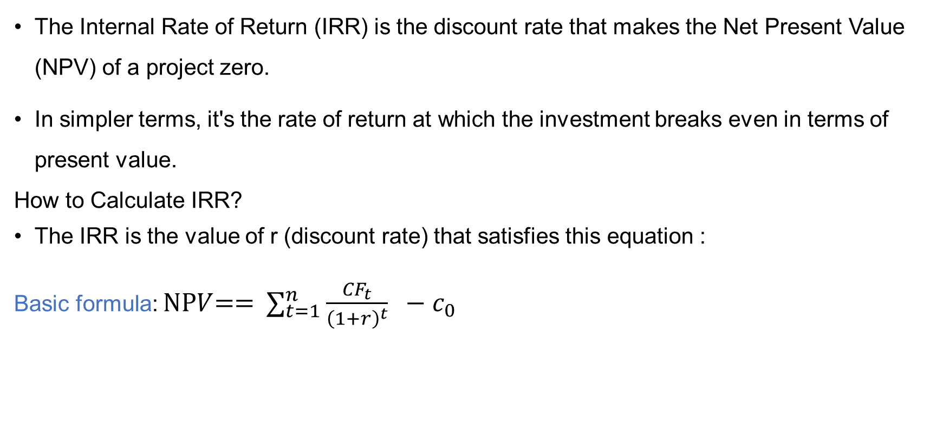
IRR (Internal Rate of Return)
The Internal Rate of Return (IRR) is the discount rate that makes the Net Present Value (NPV) of a project zero.
In simpler terms, it's the rate of return at which the investment breaks even in terms of present value.
How to Calculate IRR?
The IRR is the value of r (discount rate) that satisfies this equation :
Basic formula: NP$V$=$\text{=} ∑_{t=1}^{n}\frac{{CF}_{t}}{{\left(1+r\right)}^{t}} −c_{0}$

Slide 42
Key Characteristics of IRR
IRR is expressed as a percentage (%).
It represents the annualized rate of return expected from a project.
It is the breakeven discount rate — where investment equals return.
IRR vs Cost of Capital (r) | Decision
IRR > r | Accept the project
IRR < r | Reject the project
IRR = r | Indifferent

Slide 43

How to Calculate IRR
Question:
Invest ₹ 8,000 now. Receive ₹ 3,000 each year for 3 years. Find IRR.
Answer:
Step 1: Use IRR formula:
= -8,000+ $\frac{3000}{(1+r)}$+ $\frac{3000}{{\left(1+r\right)}^{1}}+\frac{3000}{{\left(1+r\right)}^{3}}$
Step 2: Trial with 6%:
NPV = -8,000 + $\frac{3000}{1.06}$ + $\frac{3000}{1.1236}+\frac{3000}{1.1910}$
NPV > 0 → IRR > 6%

Slide 44

Example: IRR Calculation
Step 3: Trial with 8%: NPV = -8,000 $\frac{3000}{1.08}$ + $\frac{3000}{1.1664}+\frac{3000}{1.2597}$
Step 4: Interpolate: IRR = 6%($\frac{19.45}{19.45+269.77}$)$×\left(8\%−6\%\right)=$ 6%+ $\frac{19.45}{289.22} ×$2%
=6%+0.134%=6.13%

Slide 45
Advantages of IRR
Easy to understand: Shows return as a simple percentage.
Accounts for time value of money.
Considers all cash flows.
Useful for comparing projects of different sizes.

Slide 46
Disadvantages of IRR
1. Multiple IRRs:
Occurs if the project has non-conventional cash flows (sign changes more than once).
May lead to confusion or a wrong decision.
2. Assumes reinvestment at IRR:
Unrealistic assumption compared to NPV (which assumes reinvestment at the cost of capital).

Slide 47
Disadvantages of IRR
3. Ignores the scale of the project:
A small project with a high IRR might create less value than a larger project with a lower IRR.
4. Not suitable for mutually exclusive projects:
May lead to wrong decisions compared to NPV.

Slide 48
When to Use IRR
You want a quick estimate of return as a percentage.
Comparing projects of similar size and duration.
Communicating performance to non-financial stakeholders.
Complementing NPV analysis (not replacing it)

Slide 49
NPV vs IRR
Feature | NPV | IRR
Type | Absolute value (₹) | Percentage rate (%)
Decision Rule | Accept if NPV > 0 | Accept if IRR > cost of capital
Reinvestment Assumption | Reinvest at cost of capital | Reinvest at IRR
Reliability | More reliable for unique decisions | Can be misleading in special cases
Multiple Rates Issue | No | Possible with non-conventional cash flows

Slide 50
Question
"How can the IRR method lead to incorrect investment decisions when evaluating mutually exclusive projects?"

Slide 51
Answer
IRR can be misleading for mutually exclusive projects because it shows the rate of return, not the actual value created. A project with a higher IRR might have a lower NPV, meaning it adds less value. Also, IRR assumes reinvestment at the IRR itself, which is unrealistic. So, NPV is more reliable for decision-making

Slide 52
Questions
What happens if a project has multiple IRRs?
Why is NPV preferred over IRR in capital budgeting? Can a project have no IRR?
What does it mean if IRR = cost of capital?
How do timing differences in cash flows affect IRR and NPV?
Can IRR and NPV give conflicting decisions? When and why?

Slide 53
Comparison of Capital Budgeting Techniques
Method | Time Value of Money | Considers All Cash Flows | Output | Best Used For
Payback Period | No | No | Years | Quick liquidity analysis
Discounted Payback | Yes | No | Years | Risk-sensitive liquidity analysis
NPV | Yes | Yes | ₹ Value | Profit-maximizing decisions
IRR | Yes | Yes | % Return | Comparing profitability

Slide 54
Questions
Question 1:
If a project has a shorter payback period but a lower NPV compared to another project, which should a company choose? Why?

Slide 55
Answer
The company should generally choose the project with the higher NPV, even if it has a longer payback period. NPV measures the total value added by the project, reflecting profitability and wealth creation. A shorter payback period focuses only on liquidity and risk recovery but ignores the overall profitability and cash flows beyond the payback point. However, if the company faces liquidity constraints or higher risk aversion, the shorter payback might be preferred.

